Slide 1


WELCOME
TO
QUANTITATIVE APTITUDE
&
REASONING CLASS

Slide 2
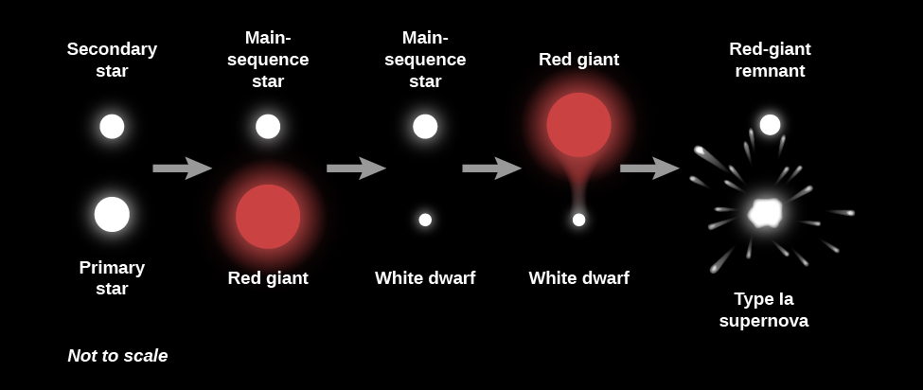
RANKING
This Photo by Unknown Author is licensed under CC BY

Slide 3
RANKING TIME SEQUENCE
1. Raju is 4th from the left and 7th rank from right How many students are there in the class?
A. 4 B. 6 C. 8 D. 10

Slide 4
RANKING
RANKING TIME SEQUENCE
2. Kiran got 15th rank from left and 41st rank from right How many students are there in the class?
A. 70
B. 54
C. 55
D. 56

Slide 5
RANKING
RANKING TIME SEQUENCE
3. In a row A is 13th from left and 31st from the right end. Find the total number of persons in the row?
A. 45 B. 44
C. 43 D. Cannot be determined

Slide 6
RANKING
RANKING TIME SEQUENCE
4. Ravi ranked sixteenth from the top and twenty ninth from the bottom among those who passed an examination. Six boys did not participate in the competition and five failed in it. How many boys were there in the class?
A. 35
B. 45
C. 50
D. 55

Slide 7
RANKING
RANKING TIME SEQUENCE
5. Mahesh is sixth from the left end and Prasanth is tenth from the right end in a row of boys. If there are eight boys between Mahesh and Prasanth, how many boys are there in the row?
A. 21
B. 23
C. 24
D. 25

Slide 8
RANKING
RANKING TIME SEQUENCE
6. In a row children Nisha is 15th from the left end and if she is shifted towards right end of the row by 4 places she becomes 8th form the right end how many children are there in the row?
A. 25
B. 26
C. 27
D. 28

Slide 9
RANKING
RANKING TIME SEQUENCE
7. In a class of boys kiran ranked 12th from the top and 36th from bottom among those who passed examination. Four boys did not participate in the competition and nine failed in it how many boys were there in the class?
A. 46 B. 47 C. 60 D. 61

Slide 10
RANKING
RANKING TIME SEQUENCE
8. A class of boys stands in a single line. One boy is 19th in order from both the ends. How many boys are their in the class
A. 36
B. 37
C. 40
D. 61

Slide 11
RANKING
RANKING TIME SEQUENCE
9. In a row of boys Jagan is 7th from the start and 11th from the end. In another row of boys, Vikram is tenth from start and 12th from the end. How many boys are there in both rows together?
A. 38
B. 37
C. 40
D. 61

Slide 12
RANKING
RANKING TIME SEQUENCE
10. In a class of 20 Joseph rank is 8th from the bottom, what is Joseph’s rank from the top?
A. 12
B. 13
C. 14
D. 15

Slide 13
RANKING
RANKING TIME SEQUENCE
11. In a class of 150 Ramya’s rank is 57th from the top, what is ramya’s rank from the bottom?
A. 38
B. 37
C. 93
D. 94

Slide 14
RANKING
RANKING TIME SEQUENCE
12. Ramya is 7 ranks ahead of serena in a class of 39 if serena’s rank is seventeenth from the last, what is ramya’s rank from the start?
A. 15
B. 16
C. 40
D. 60

Slide 15
RANKING
RANKING TIME SEQUENCE
13. In a class of 20 students, Kiran rank is 15th from the top, Ravi is 4ranks above kiran, what is the ravi rank from the bottom
A. 9 B. 10 C. 40 D. 60

Slide 16
RANKING
RANKING TIME SEQUENCE
14. In a class of 40 students, swamy rank from the top is twelth, Alok is eight ranks below swamy, what is alok rank from the bottom?
A. 19 B. 20 C. 21 D. 39

Slide 17
RANKING
RANKING TIME SEQUENCE
15. In a row of 21 girls, when Bharani was shifted by four places towards the right, she became 12th from the left end, what was her earlier position from the right end of the row?
A.13 B. 14 C. 8 D. 9

Slide 18
RANKING
RANKING TIME SEQUENCE
16. In a row of boys john is 7th from the left and Ravi is 9th from the right, Both of them interchange their positions and thus john becomes 11th from the left, How many people are there in that row?
A.16 B. 17 C. 18 D. 19

Slide 19
RANKING
RANKING TIME SEQUENCE
17. In a row of children, Deepu is fifth from the left and vinay is sixth from the right. When they inter change their places. Deppu becomes 13th form the left, then what will be vinay’s position from the right?
A.13 B. 14 C. 15 D. 16

Slide 20
RANKING
RANKING TIME SEQUENCE
18. In a row A is 18th from the front while B is 16th from the back If C is 25th from the front and is exactly in the middle of A and B, then how many persons are there in the row?
A.47 B. 48
C. 49 D. 50

Slide 21
RANKING
RANKING TIME SEQUENCE
19. In a row of boys facing the north, A is 16th from the left end and C is 16th From the right end. B, who is fourth to the right A, is fifth to the left of C in the row. How many boys are there in the row?
A.39 B. 40 C. 41 D. 42

Slide 22
RANKING
RANKING TIME SEQUENCE
20.Three persons A, B and C are standing in a row. There are five persons between A and B and eight persons between B and C. if there are three persons ahead of C and 21 behind A, then what could be the minimum number of persons in the row?
A.27 B. 28 C. 40 D. 41

Slide 23
RANKING
RANKING TIME SEQUENCE
21. In a queue, Viji is fourteenth from the front and Jack is seventeenth from the end, while Mary is in between Viji and Jack. If Viji be ahead of Jack and there be 48 persons in the queue, how many persons are there between Viji and Mary?
A. 5
B. 6
C. 7
D. 8

Slide 24
RANKING
RANKING TIME SEQUENCE
22. In a row of girls facing North, Reena is 10th to the left of Pallavi, who is 21st from the right end. If Malini, who is 17th from the left end, is fourth to the right of Reena, how many girls are there in the row?
A. 37
B. 41
C. 43
D. 49

Slide 25
RANKING
RANKING TIME SEQUENCE
23. In a row of boys, Rohit is eighth from the right and Nikhil is twelfth from the left. When Rohit and Nikhil interchange positions, Nikhil becomes 21st from the left. Which of the following will be Rohit's position from the right?
A. 8th
B. 17th
C. 21st
D. Cannot be determined

Slide 26
RANKING
RANKING TIME SEQUENCE
For a 100 m race, there are six contestants -Aarti, Bharati, Chandni, Divya, Esha, and Flora.
I.Aarti beats only Bharati and Flora
II.Esha was beaten by Divya only
III.Bharati did not come last in the race
IV.Race was finished in 55 sec. by the bronze medallist
V.Bharati finished the race in 63 seconds
24. Which of the following could be Aarti’s time?
A. 40
B. 51
C. 61
D. 64

Slide 27
RANKING
RANKING TIME SEQUENCE
For a 100 m race, there are six contestants -Aarti, Bharati, Chandni, Divya, Esha, and Flora.
I.Aarti beats only Bharati and Flora
II.Esha was beaten by Divya only
III.Bharati did not come last in the race
IV.Race was finished in 55 sec. by the bronze medallist
V.Bharati finished the race in 63 seconds
25. According to the above-mentioned question, if the gold medallist beat Chandni by 20 seconds. Which of the following could be Esha’s time?
A. 31
B. 41
C. 57
D. 60

Slide 28
RANKING
RANKING TIME SEQUENCE
A, B, C, D, E, F, and G are seven persons who travel to the office every day by a particular train which stops at only five stations – I, II, III, IV, and V respectively after it leaves the base station.
Three among them get on the train at the base station. D gets down at the station next at which F gets down. B does not get down either with E or A. At station III; G alone gets in and gets down with C after one station. A travels between two stations only and gets down at station V. No one gets in at station II. F gets in with C. C does not get in with either B or D. E gets in with two others persons and gets down alone after D. B and D work together in the same office and they get down together at station III. None gets down at station I.

Slide 29
RANKING
RANKING TIME SEQUENCE
A, B, C, D, E, F, and G are seven persons who travel to the office every day by a particular train which stops at only five stations – I, II, III, IV, and V respectively after it leaves the base station.
Three among them get on the train at the base station. D gets down at the station next at which F gets down. B does not get down either with E or A. At station III; G alone gets in and gets down with C after one station. A travels between two stations only and gets down at station V. No one gets in at station II. F gets in with C. C does not get in with either B or D. E gets in with two others persons and gets down alone after D. B and D work together in the same office and they get down together at station III. None gets down at station I.
26. At which station does E get down of the train?
A. Station II
B. Station III
C. Station IV
D. None of the above

Slide 30
RANKING
RANKING TIME SEQUENCE
A, B, C, D, E, F, and G are seven persons who travel to the office every day by a particular train which stops at only five stations – I, II, III, IV, and V respectively after it leaves the base station.
Three among them get on the train at the base station. D gets down at the station next at which F gets down. B does not get down either with E or A. At station III; G alone gets in and gets down with C after one station. A travels between two stations only and gets down at station V. No one gets in at station II. F gets in with C. C does not get in with either B or D. E gets in with two others persons and gets down alone after D. B and D work together in the same office and they get down together at station III. None gets down at station I.
27. At which station do C and F get in together?
A. Station I
B. Station II
C. Station III
D. Data inadequate

Slide 31
RANKING
RANKING TIME SEQUENCE
A, B, C, D, E, F, and G are seven persons who travel to the office every day by a particular train which stops at only five stations – I, II, III, IV, and V respectively after it leaves the base station.
Three among them get on the train at the base station. D gets down at the station next at which F gets down. B does not get down either with E or A. At station III; G alone gets in and gets down with C after one station. A travels between two stations only and gets down at station V. No one gets in at station II. F gets in with C. C does not get in with either B or D. E gets in with two others persons and gets down alone after D. B and D work together in the same office and they get down together at station III. None gets down at station I.
28. At which station do B and D get in?
A. Station I
B. Base station
C. Station III
D. Data inadequate

Slide 32
RANKING
RANKING TIME SEQUENCE
A, B, C, D, E, F, and G are seven persons who travel to the office every day by a particular train which stops at only five stations – I, II, III, IV, and V respectively after it leaves the base station.
Three among them get on the train at the base station. D gets down at the station next at which F gets down. B does not get down either with E or A. At station III; G alone gets in and gets down with C after one station. A travels between two stations only and gets down at station V. No one gets in at station II. F gets in with C. C does not get in with either B or D. E gets in with two others persons and gets down alone after D. B and D work together in the same office and they get down together at station III. None gets down at station I.
29. After how many stations does E get down?
A. One
B. Two
C. Three
D. Four

Slide 33
RANKING
RANKING TIME SEQUENCE
A, B, C, D, E, F, and G are seven persons who travel to the office every day by a particular train which stops at only five stations – I, II, III, IV, and V respectively after it leaves the base station.
Three among them get on the train at the base station. D gets down at the station next at which F gets down. B does not get down either with E or A. At station III; G alone gets in and gets down with C after one station. A travels between two stations only and gets down at station V. No one gets in at station II. F gets in with C. C does not get in with either B or D. E gets in with two others persons and gets down alone after D. B and D work together in the same office and they get down together at station III. None gets down at station I.
30. After how many stations does E gets down at which F gets down?
A. One
B. Two
C. Three
D. Four

Slide 34
RANKING TIME SEQUENCE
1. | D | 11. | D | 21. | D
2. | C | 12. | B | 22. | C
3. | C | 13. | B | 23. | B
4. | D | 14. | C | 24. | D
5. | C | 15. | B | 25. | B
6. | B | 16. | D | 26. | C
7. | C | 17. | B | 27. | D
8. | B | 18. | A | 28. | D
9. | A | 19. | B | 29. | C
10. | B | 20. | B | 30. | B

Slide 35


